Slide 1
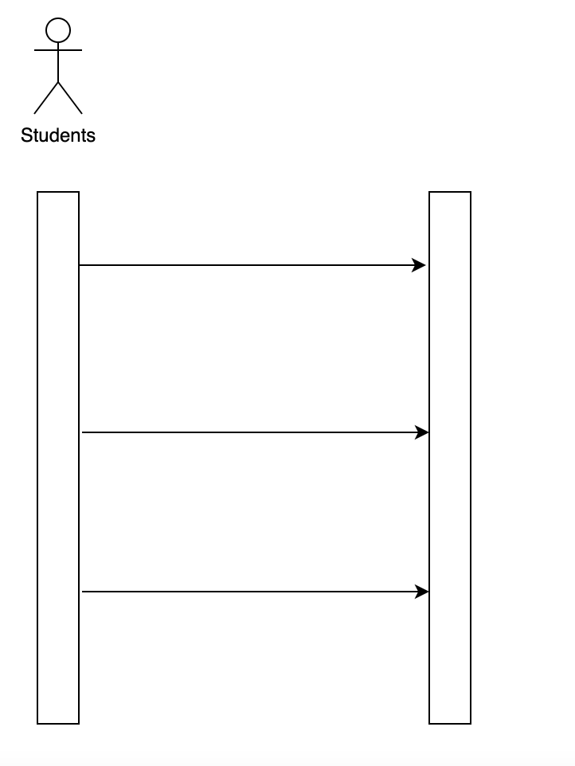
Sequence Diagram (Unipath)
Use case 01.01 Account Authentication
Students account
login( )
register( )
logOut( )

Slide 2
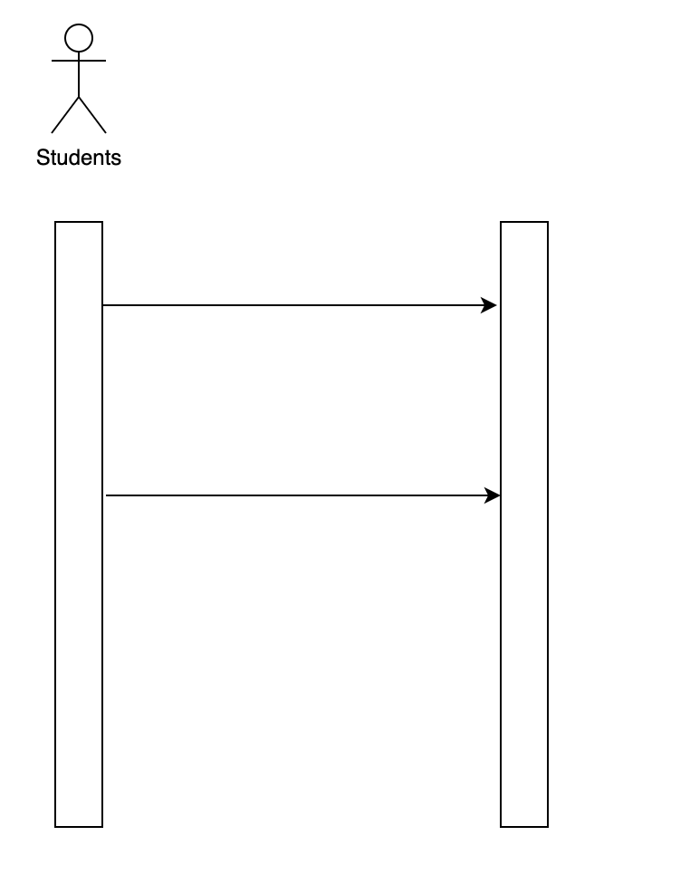
Sequence Diagram (Unipath)
Use case 01.02 Account Summary
Students account
changeName( )
updateInfo( )

Slide 3
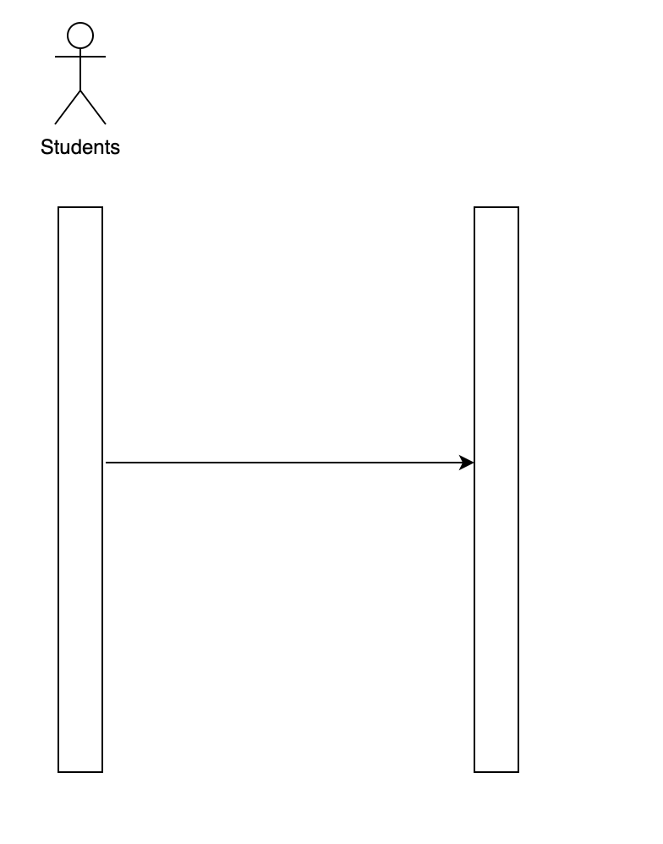
Sequence Diagram (Unipath)
Use case 01.03 Customer Support
Students account
getSupport( )

Slide 4
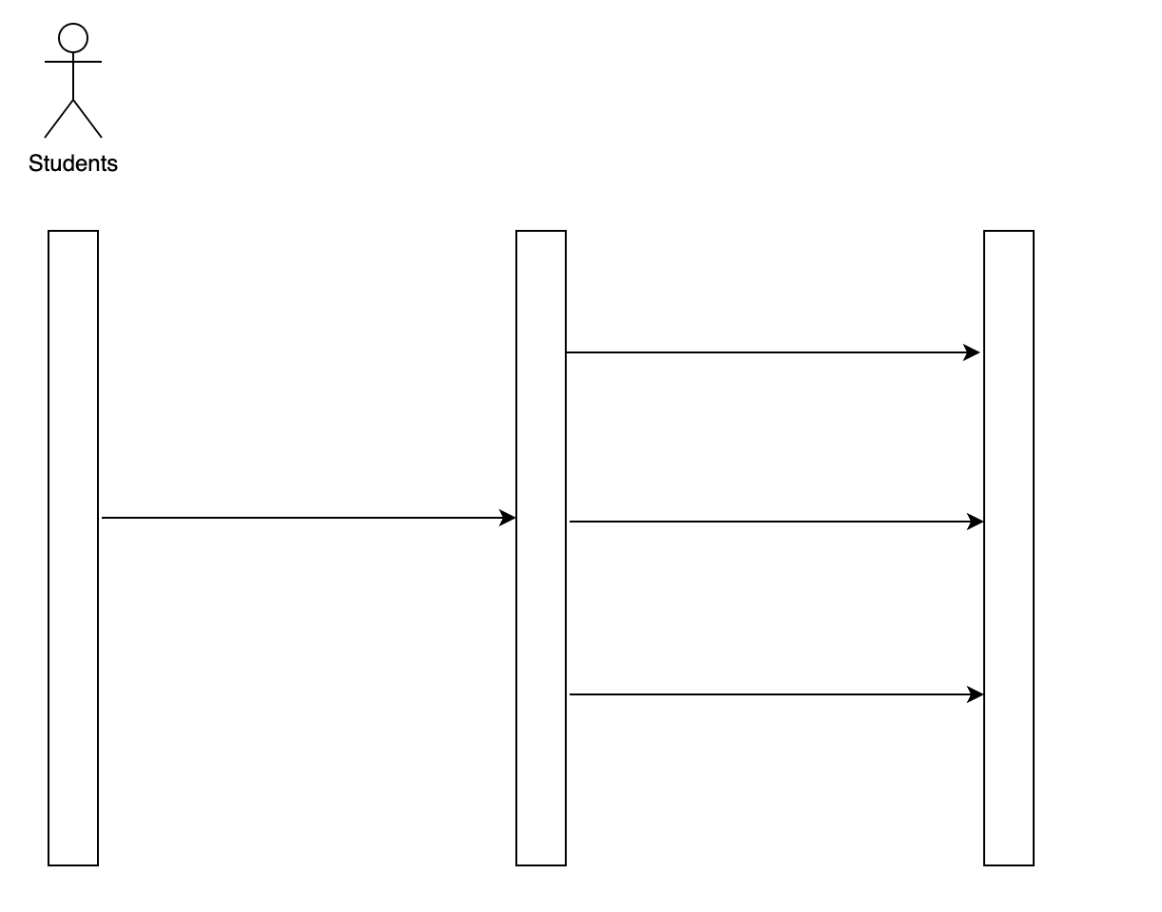
Sequence Diagram (Unipath)
Use case 02.01 Browse Products
Students account
Products
getCategory( )
login( )
getGoodsById( )
searchGoods( )

Slide 5
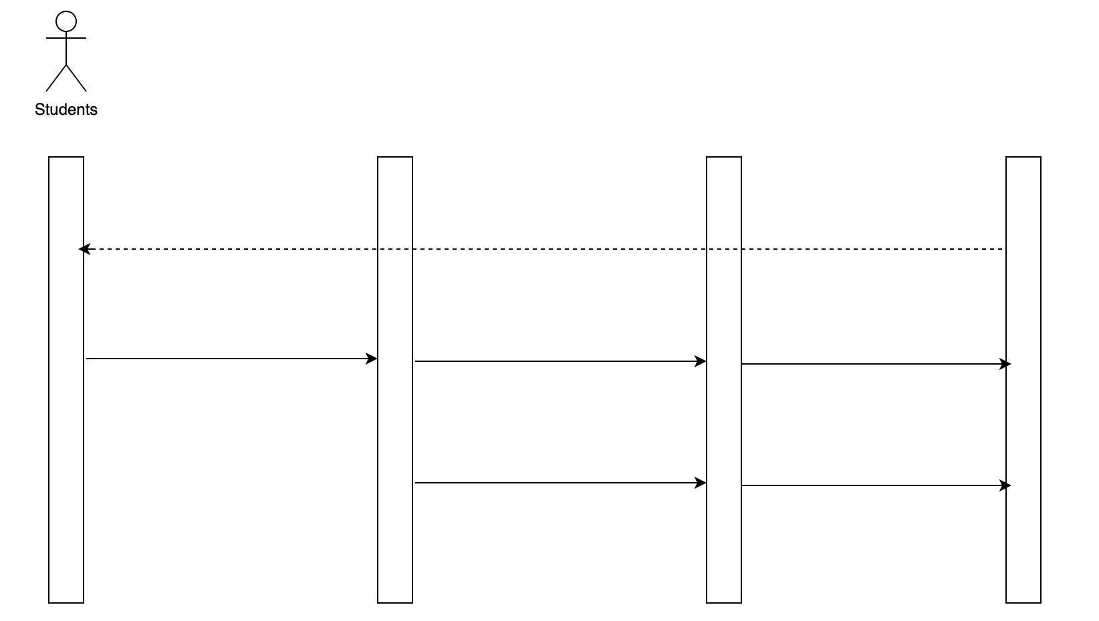
Sequence Diagram (Unipath)
Use case 02.02 Make Payment
Students account
Products
Orders
receipt( )
login( )
searchGoods( )
addOdders( )
getGoodsById( )
deliver( )

Slide 6
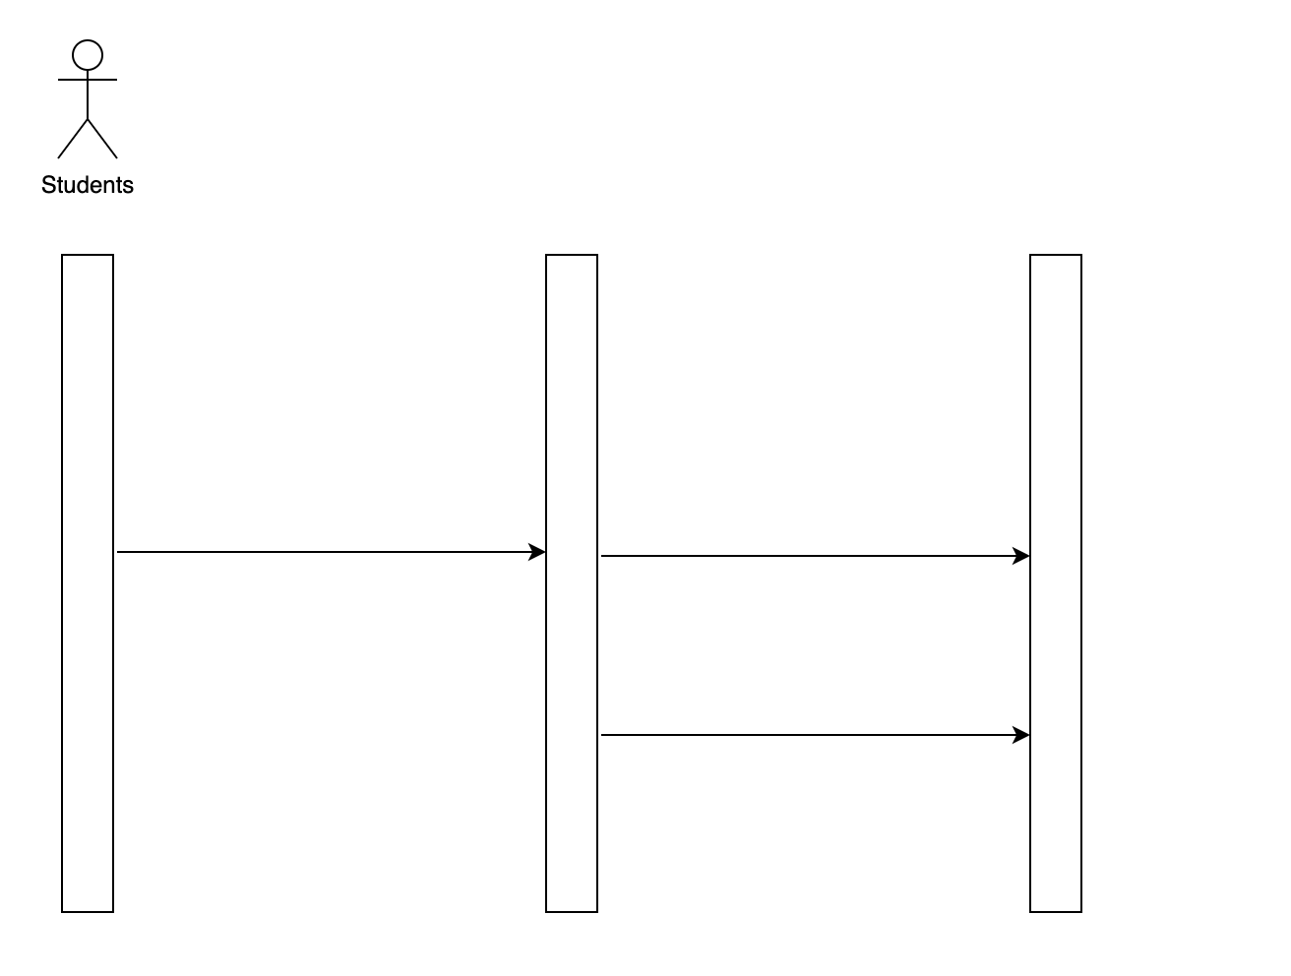
Sequence Diagram (Unipath)
Use case 02.03 Upload Products
Students account
Upload products
login( )
upload( )
editGoods( )

Slide 7
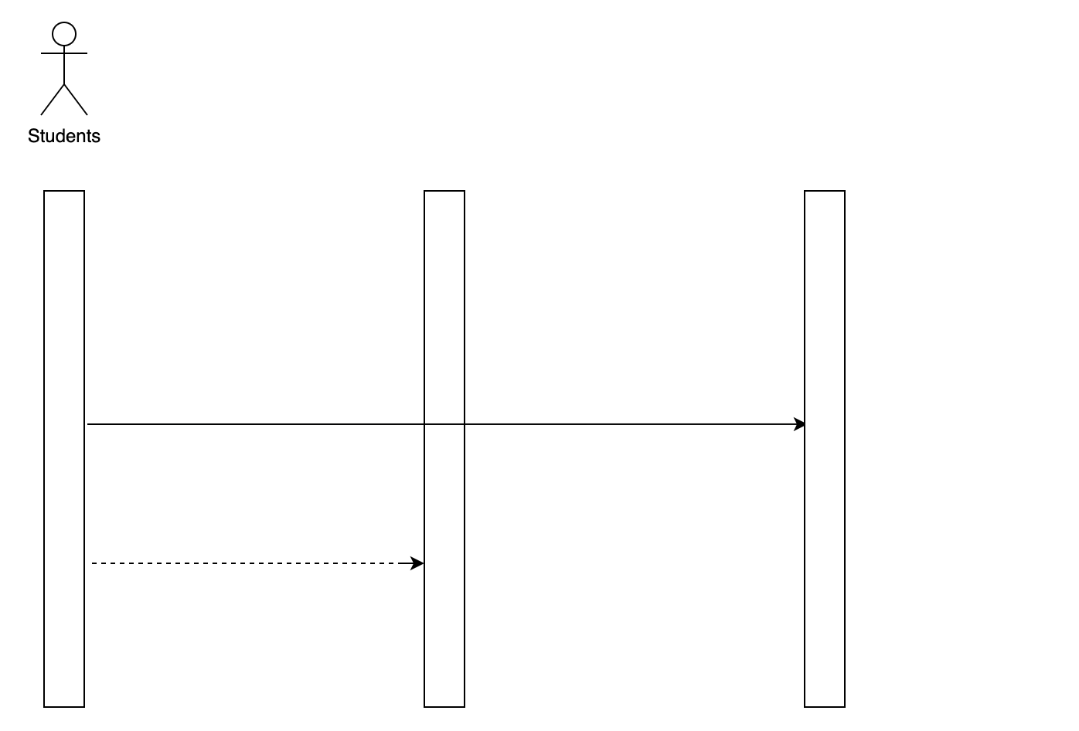
Sequence Diagram (Unipath)
Use case 02.04 Submit Rating
Products
Rating
getContent( )
receipt( )

Slide 8
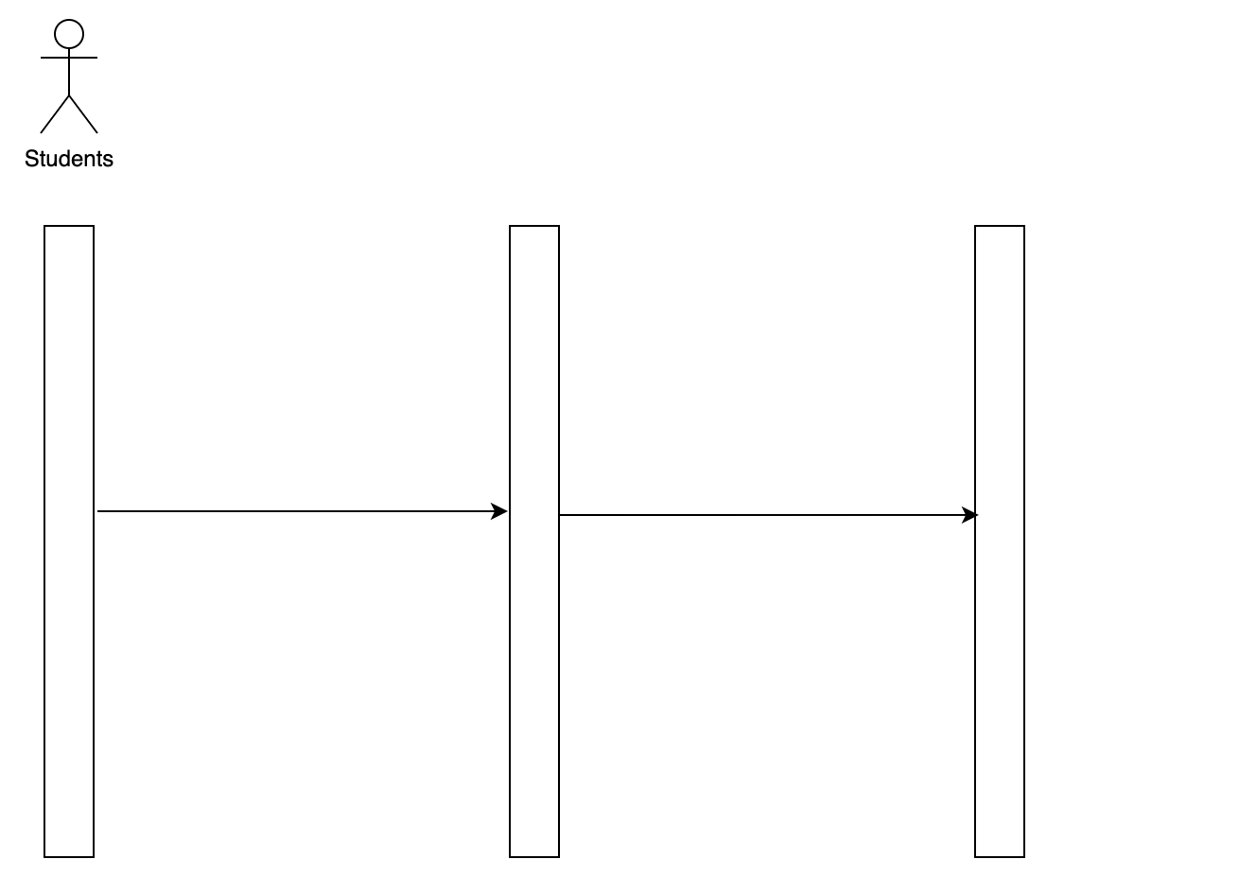
Sequence Diagram (Unipath)
Use case 02.05 Post Review
Students account
Rating
login( )
getContent( )

